Slide 1
The Mechanics of the Knee
Example 3
Milan S. Kovačević
Faculty of Science, Department of Physics
University of Kragujevac
Serbia
e-mails: kovac@kg.ac.rs
milan.kovacevic@pmf.kg.ac.rs
Foča, BiH, 2022.

Slide 2
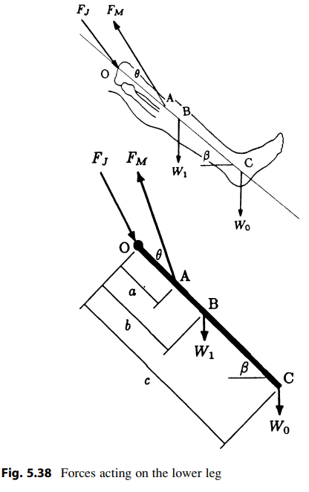
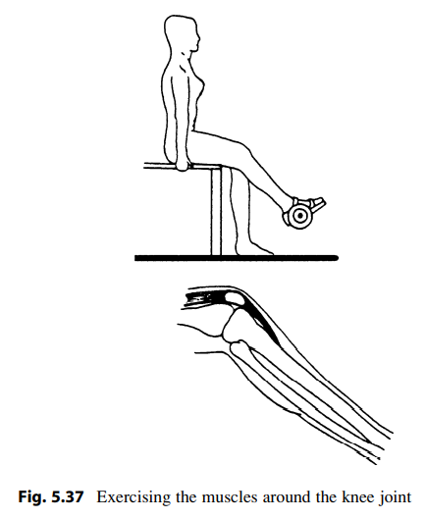
Forces acting on the lower angle
Consider a person wearing a weight boot, and from a sitting position, doing lower leg flexion/extension exercises to strengthen the quadriceps muscles (Fig. 5.37).
Forces acting on the lower leg and a simple mechanical model of the leg are illustrated in Fig. 5.38.
Foča, BiH, 2022.

Slide 3
Mechanical model - description
W₁ is the weight of the lower leg, W₀ is the weight of the boot, F_{M} is the magnitude of the tensile force exerted by the quadriceps muscle on the tibia through the patellar tendon, and F_{J} is the magnitude of the tibiofemoral joint reaction force applied by the femur on the tibial plateau.
The tibiofemoral joint center is located at point O, the patellar tendon is attached to the tibia at point A, the center of gravity of the lower leg is located at point B, and the center of gravity of the weight boot is located at point C.
The distances between point O and points A, B, and C are measured as a, b, and c, respectively. For the position of the lower leg shown, the long axis of the tibia makes an angle β with the horizontal, and the line of action of the quadriceps muscle force makes an angle θ with the long axis of the tibia.
Foča, BiH, 2022.

Slide 4
The task
Assuming that points O, A, B, and C all lie along a straight line, determine F_{M} and F_{J} in terms of a; b; c; θ; β; W₁, and W₀.
Foča, BiH, 2022.

Slide 5
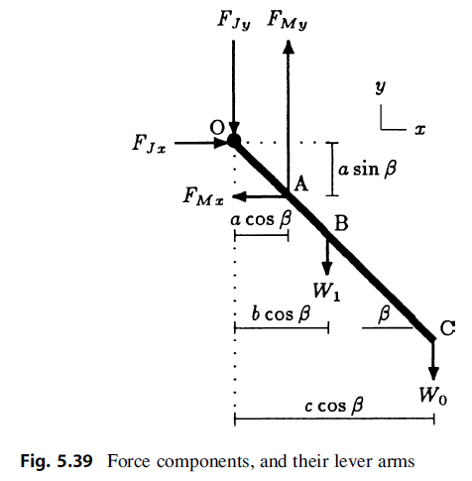
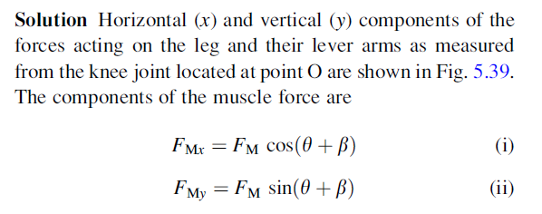
The solution
Foča, BiH, 2022.

Slide 6
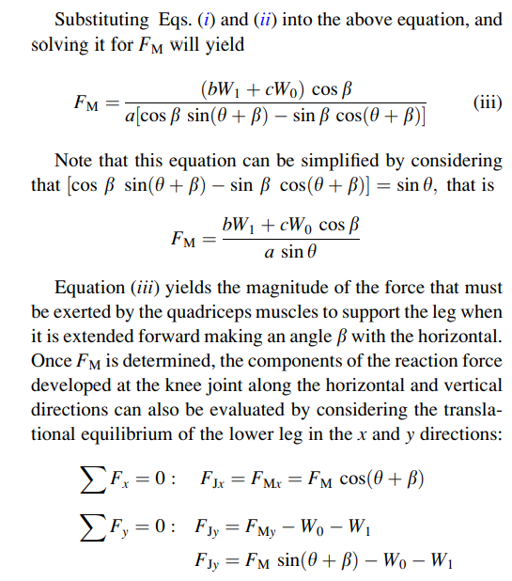
The Solution
Foča, BiH, 2022.

Slide 7
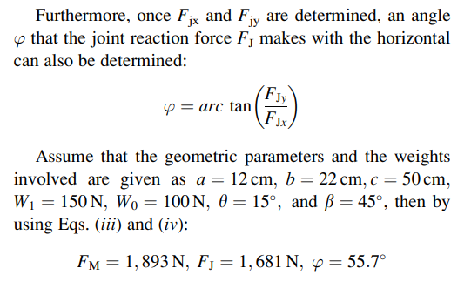
The Solution – The magnitude of the resultant compressive force applied on the tibial plateau at the knee joint
The magnitude of the resultant compressive force applied on the tibial plateau at the knee joint is
Foča, BiH, 2022.

Slide 8
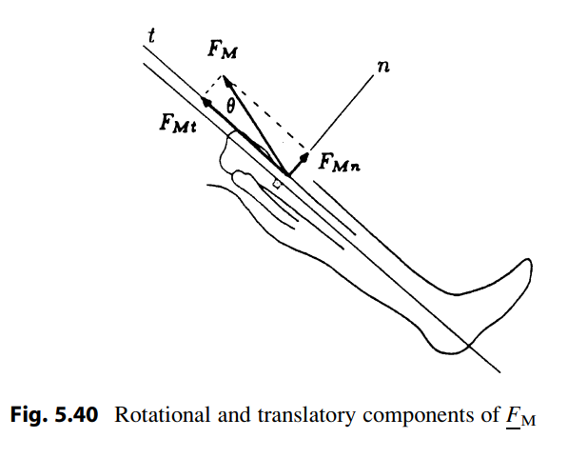
Remarks
The force F_{M} exerted by the quadriceps muscle on the tibia through the patellar tendon can be expressed in terms of two components normal and tangential to the long axis of the tibia (Fig. 5.40). The primary function of the normal component F_{Mn} of the muscle force is to rotate the tibia about the knee joint, while its tangential component F_{Mt} tends to translate the lower leg in a direction collinear with the long axis of the tibia and applies a compressive force on the articulating surfaces of the tibiofemoral joint. Since the normal component of F_{M} is a sine function of angle θ, a larger angle between the patellar tendon and the long axis of the tibia indicates a larger rotational effect of the muscle exertion. This implies that for large θ, less muscle force is wasted to compress the knee joint, and a larger portion of the muscle tension is utilized to rotate the lower leg about the knee joint.
Foča, BiH, 2022.

Slide 9
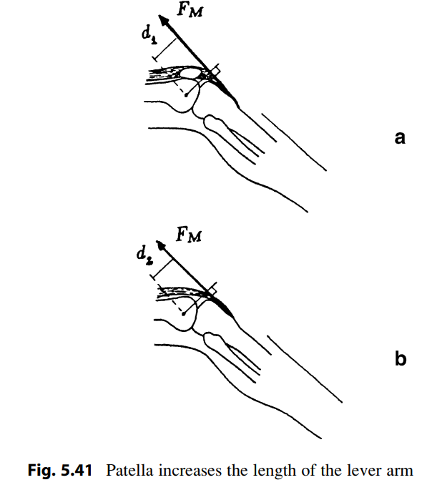
Remarks
One of the most important biomechanical functions of the patella is to provide anterior displacement of the quadriceps and patellar tendons, thus lengthening the lever arm of the knee extensor muscle forces with respect to the center of rotation of the knee by increasing angle θ (Fig. 5.41a). Surgical removal of the patella brings the patellar tendon closer to the center of rotation of the knee joint (Fig. 5.41b), which causes the length of the lever arm of the muscle force to decrease d₂<d₁. Losing the advantage of having a relatively long lever arm, the quadriceps muscle has to exert more force than normal to rotate the lower leg about the knee joint

Slide 10
Thank you for your atention!
Dr Milan Kovačević, Full Professor
Faculty of Science, Department of Physics
University of Kragujevac
kovac@kg.ac.rs
milan.kovacevic@pmf.kg.ac.rs
Foča, BiH, 2022.

